Slide 1

公司介绍
上海金弘通信息科技有限公司，前身深耕行业服务领域，凭借多年专业积淀积累了深厚资源网络与良好行业口碑。创始人曾深度参与 “一带一路” 技术出口相关项目，积淀了优质政企合作背书，如今公司精准锚定外贸市场机遇，战略升级聚焦纸板箱等核心包装耗材的国内外贸易主业。
秉持 “诚信为本、贸易赋能、服务致远” 的核心理念，公司构建 “优质供应链整合 - 全场景产品适配 - 全球渠道交付” 闭环服务体系。我们严保产品符合国内外市场标准，满足食品保鲜、跨境物流等多场景包装需求，依托成熟全球渠道与高效国内分销网络，提供高性价比、具市场竞争力的贸易服务，持续深耕国内外包装耗材贸易领域。

Slide 2
Company Introduction
Shanghai Jinhongtong Information Technology Co., Ltd., with its predecessor deeply rooted in the industrial service sector, has accumulated an extensive resource network and a sound industry reputation through years of professional experience. Having participated in the "Belt and Road" technology export projects and backed by favorable government support, the company now accurately seizes the broad prospects of the foreign trade market, launches a strategic upgrade, and fully focuses on the core business of domestic and international trade of key packaging materials such as cartons.
Adhering to the core philosophy of "Integrity-Based, Trade-Empowered, Service for Longevity", the company has built a closed-loop service system featuring "Premium Supply Chain Integration – Full-Scenario Product Adaptation – Global Channel Delivery". We strictly ensure that our products comply with domestic and international market standards, and meet the packaging needs of various scenarios such as food preservation and cross-border logistics. Leveraging mature global channels and an efficient domestic distribution network, we provide cost-effective and market-competitive trade services, and continue to deepen our presence in the domestic and international packaging materials trade sector.

Slide 3
目 录
硬纸箱 Carton

Slide 4
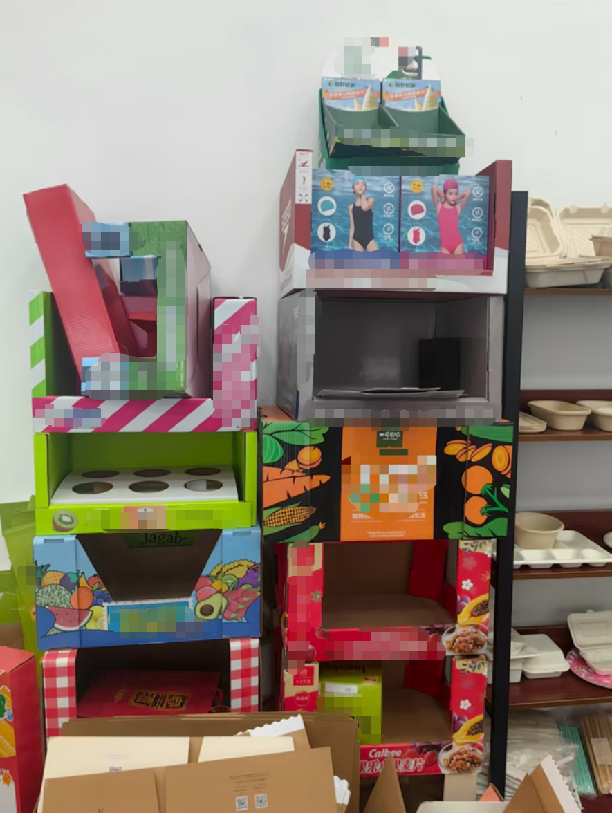
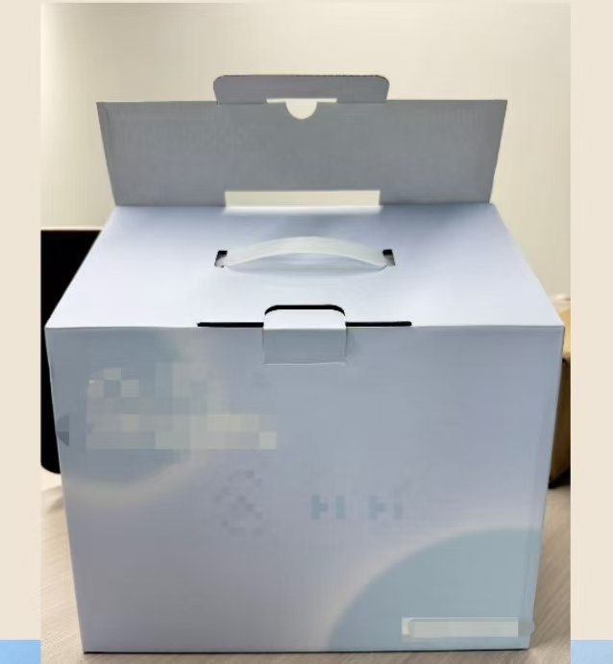
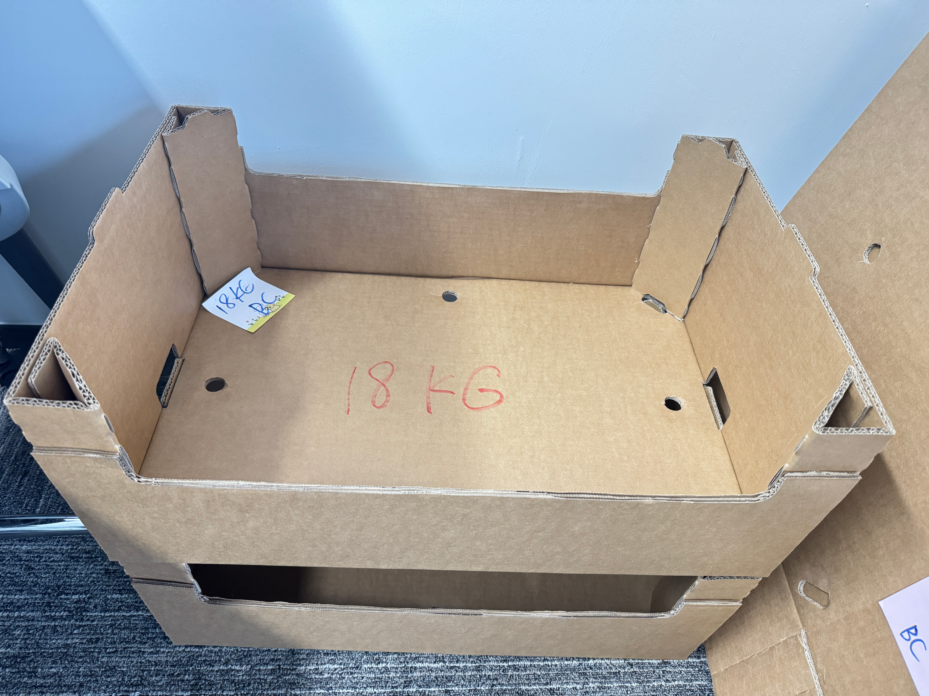
01
硬纸箱
Carton

Slide 5

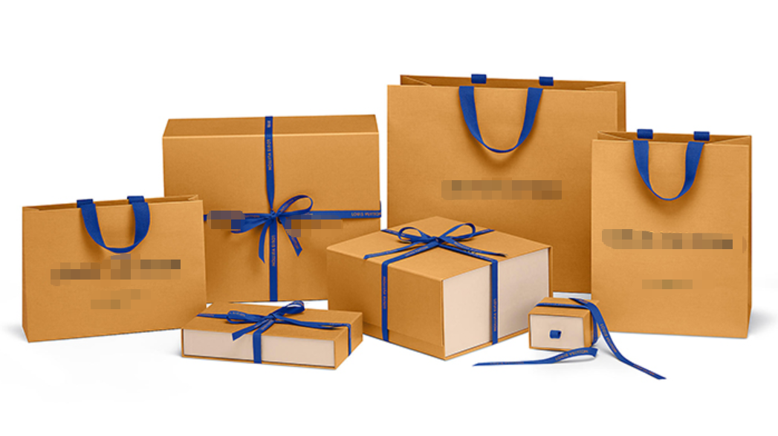
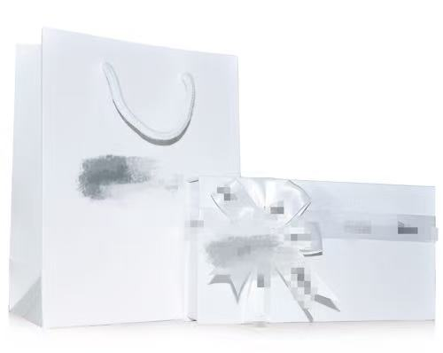
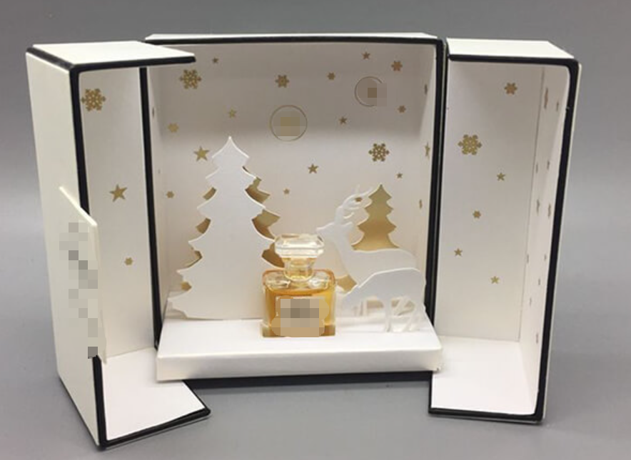
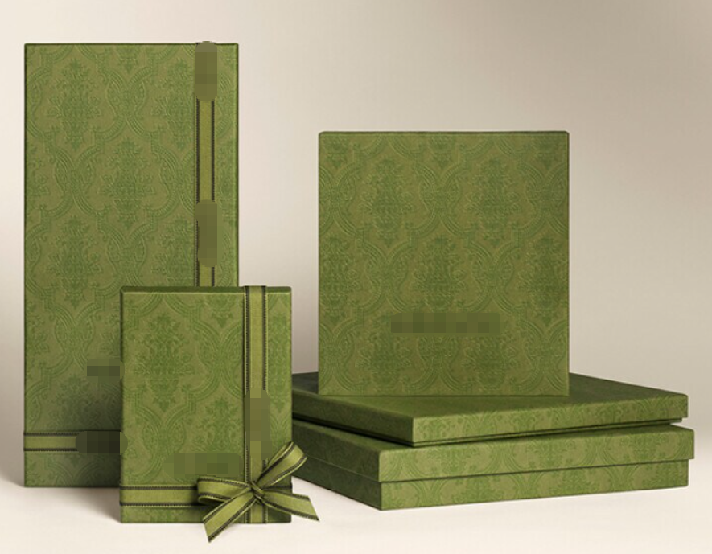
各种包装耗材均可定制
All types of packaging materials are customizable.

Slide 6
硬纸箱 Carton
纸箱是由瓦楞纸板制成的包装容器，广泛应用于物流、仓储、电商、食品、电子、医药等行业。其结构轻便、抗压性强、可定制印刷，是现代化运输和商品包装的核心解决方案。
Corrugated boxes are packaging containers made from corrugated fiberboard, widely used in logistics, warehousing, e-commerce, food, electronics, pharmaceutical industries and more. Featuring lightweight construction, excellent compression resistance and customizable printing options, they serve as a core solution for modern transportation and commercial packaging.

Slide 7
高强度
B楞抗压+C楞缓冲组合，边压强度高，适合堆码运输。
印刷适应性强
平整纸面适合高清印刷，提升整体形象。
纸箱楞型
组合BC楞
环保经济
100%可回收，成本低于木箱/塑料箱。
防震防摔
组合结构有效分散冲击力，保护易碎品。

Slide 8
High-Strength
Combining compression resistance and cushioning properties with high ECT, this design is ideal for stacked transportation.
Excellent Printability
The smooth surface ensures high-definition printing, enhancing brand image.
Flute Type
BC-flute
Shockproof
Drop-resistant
The composite structure effectively disperses impact forces to protect fragile contents.
Eco-Economical
100% recyclable with lower costs compared to wooden or plastic crates.

Slide 9
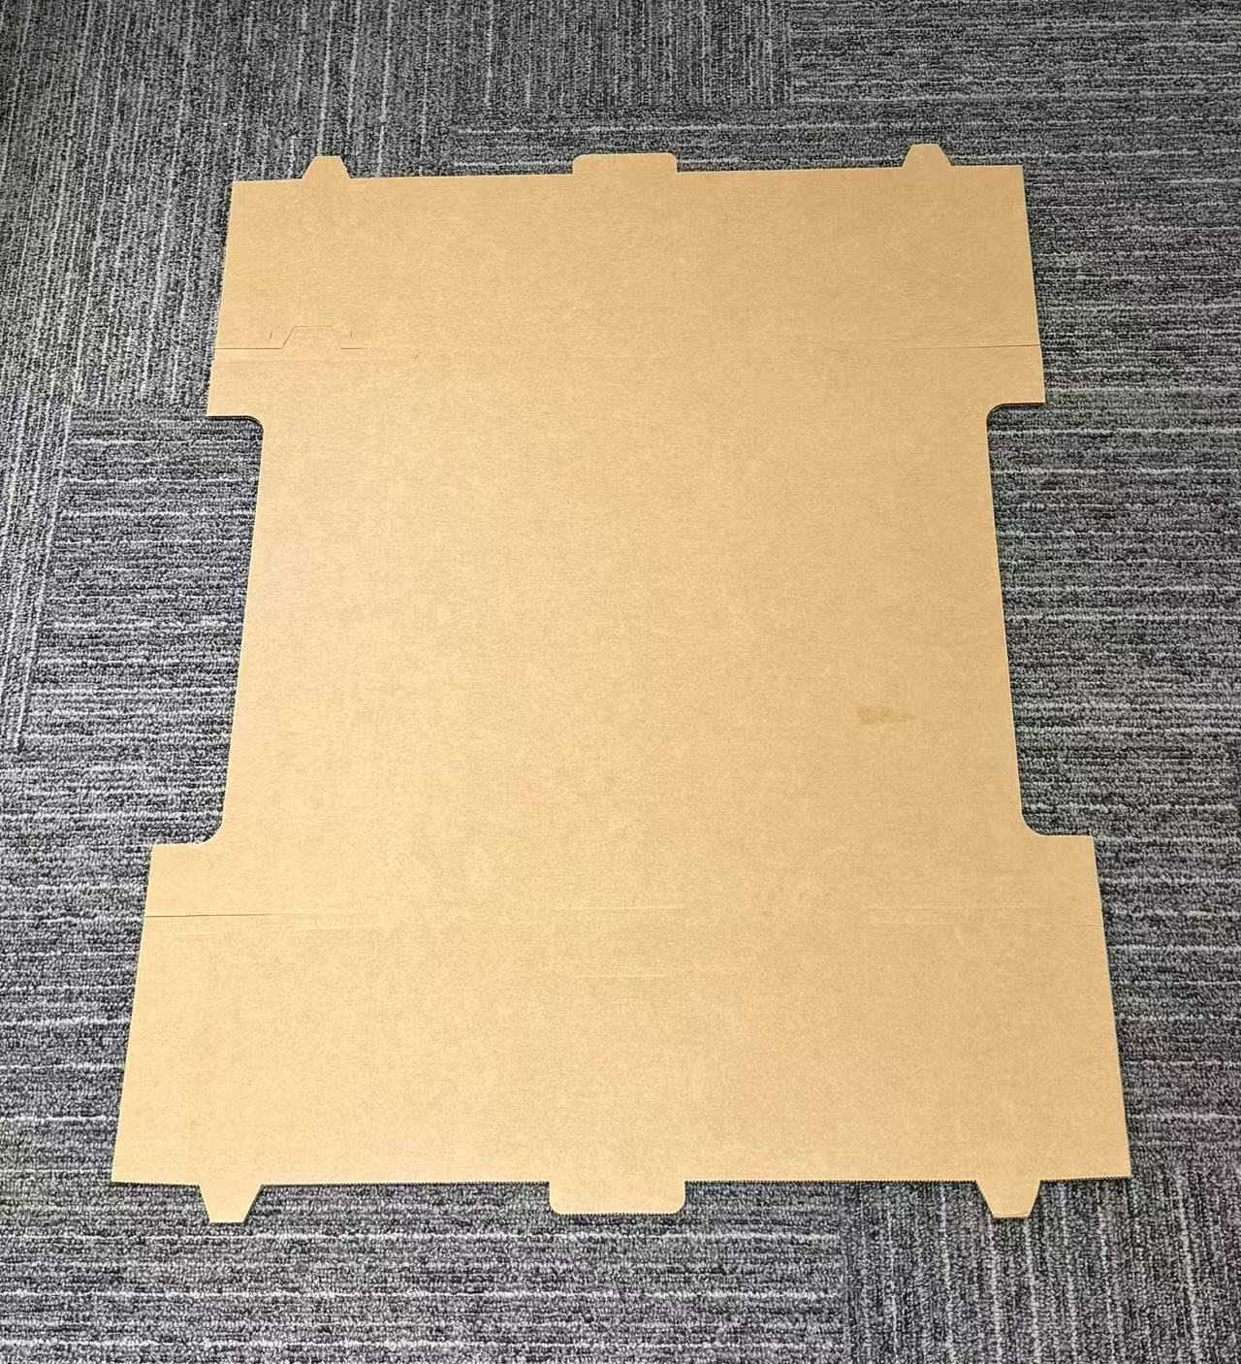
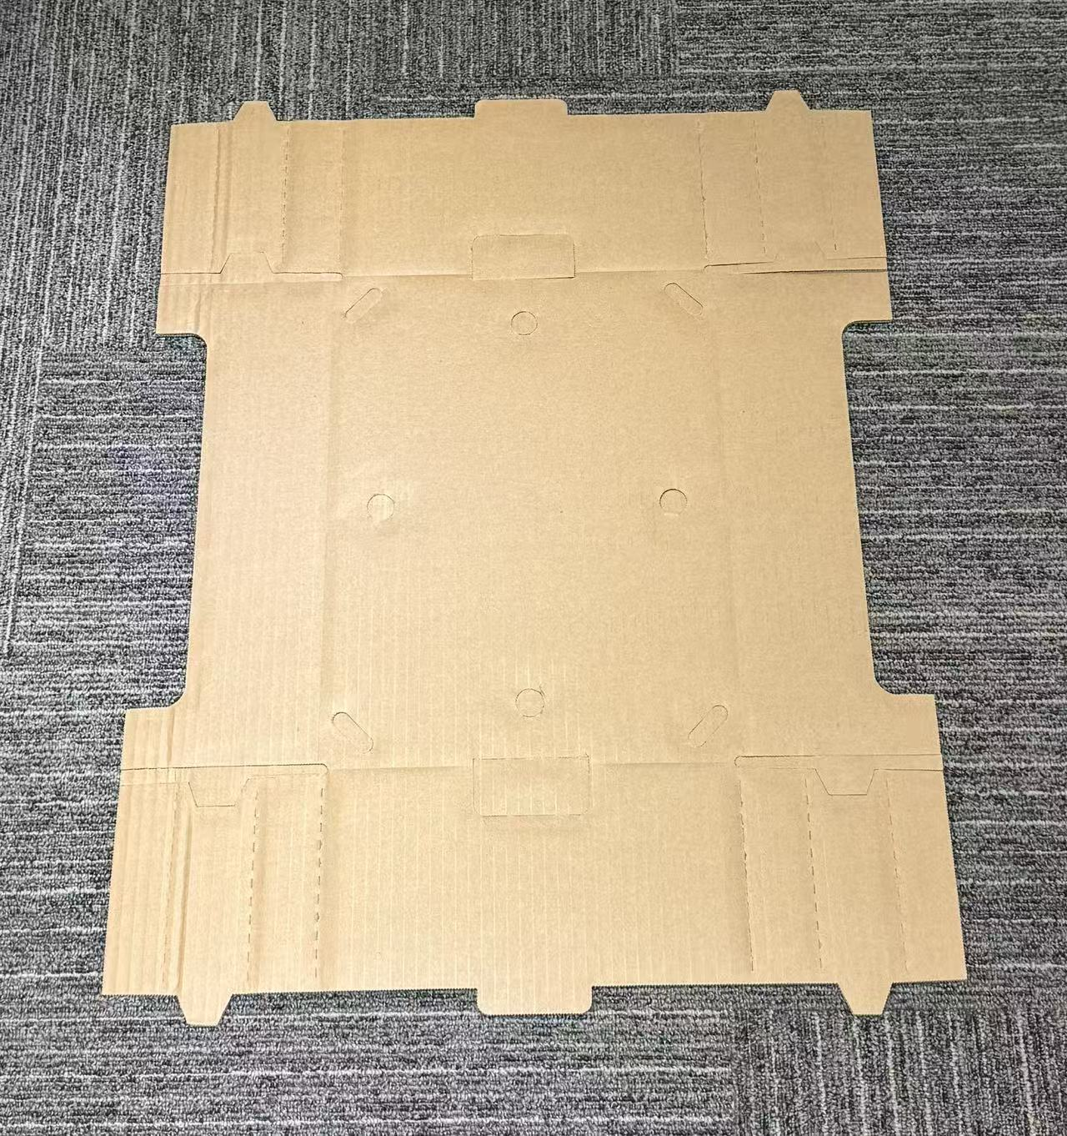
平 面
展 示
Graphic Display

Slide 10
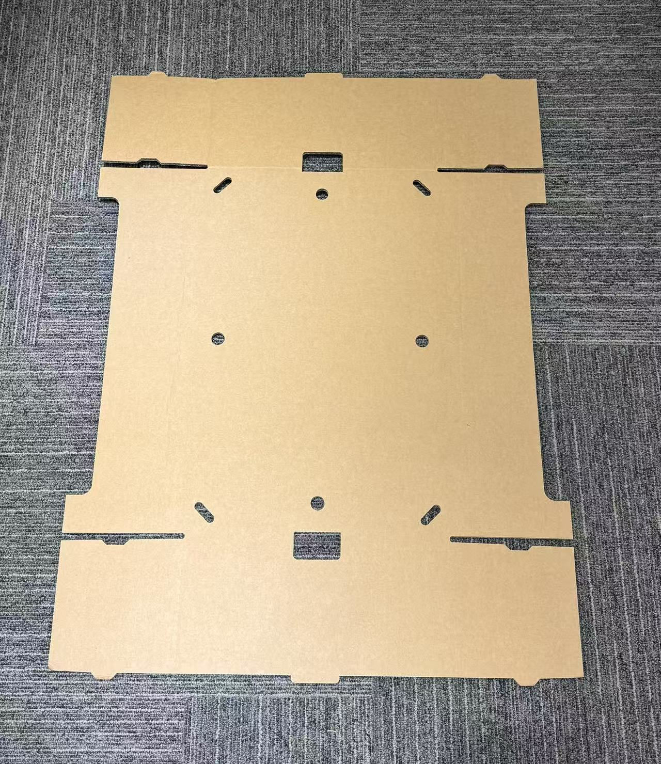
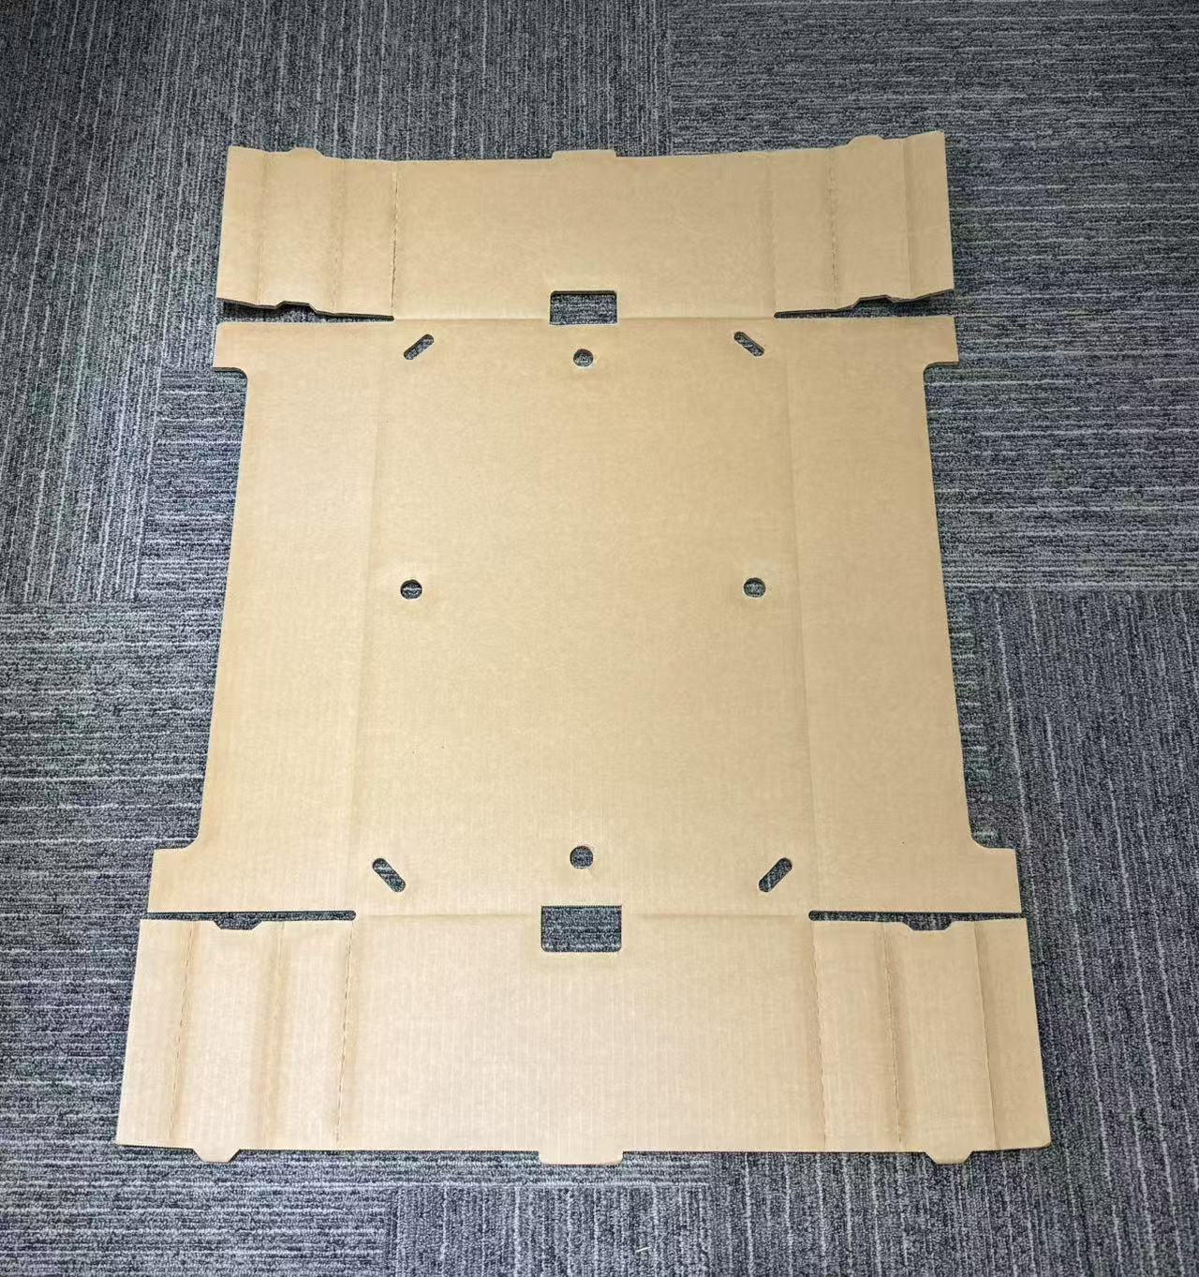
平 面
展 示
Graphic Display

Slide 11
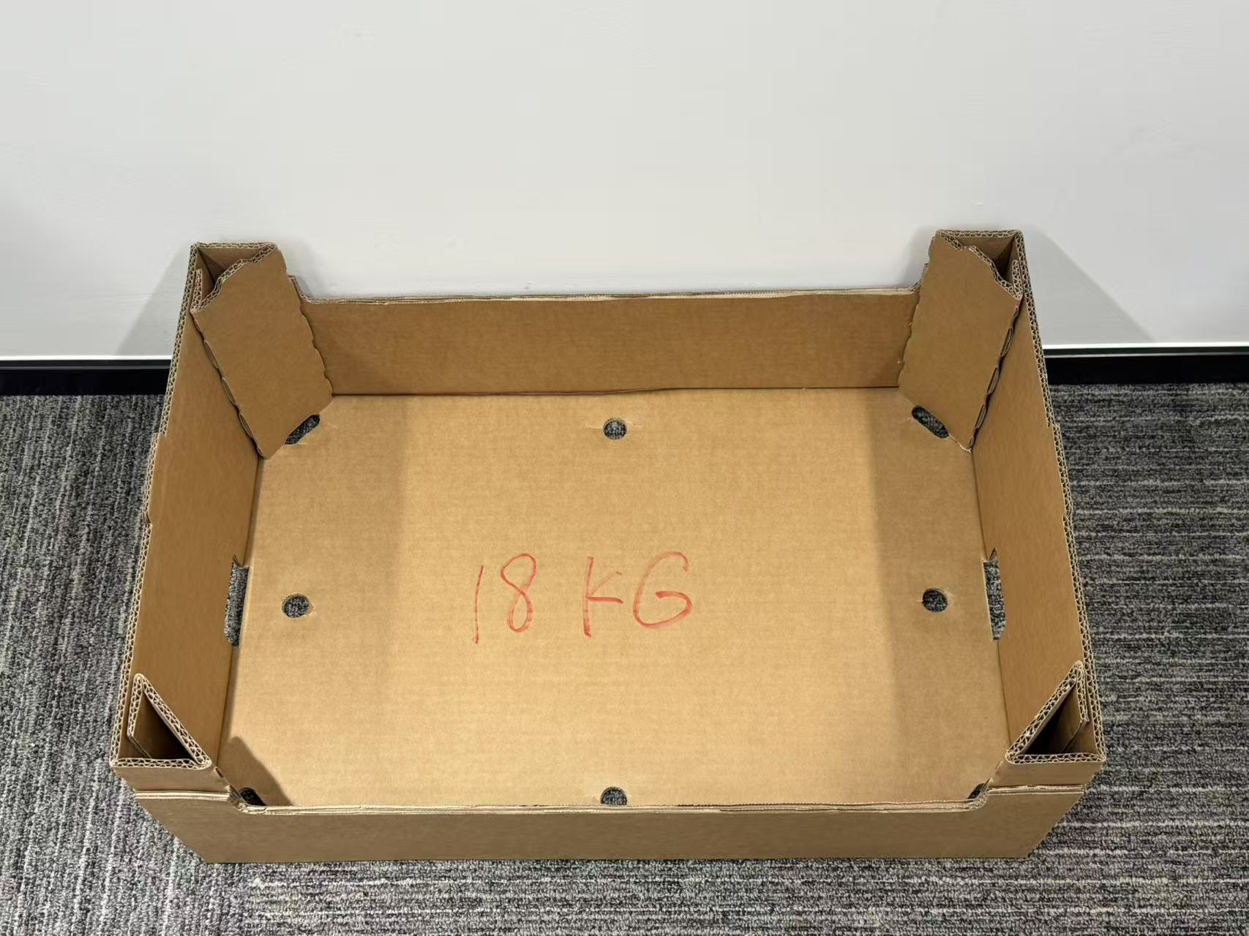
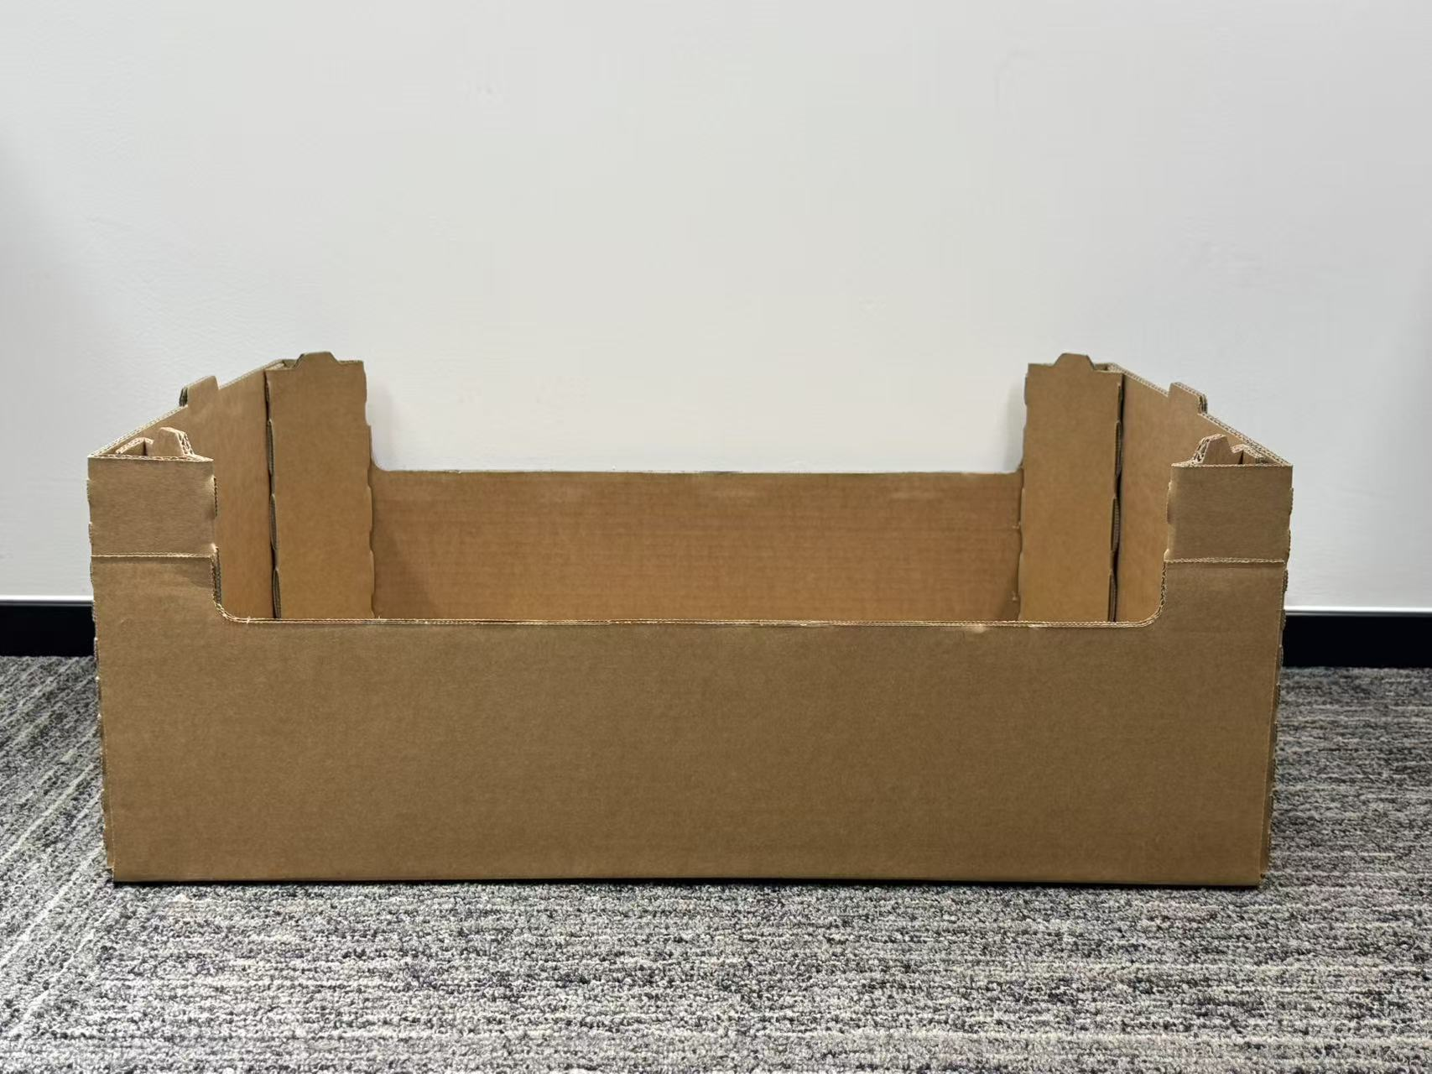
组 装 后 实 物 展 示
Physical Display

Slide 12
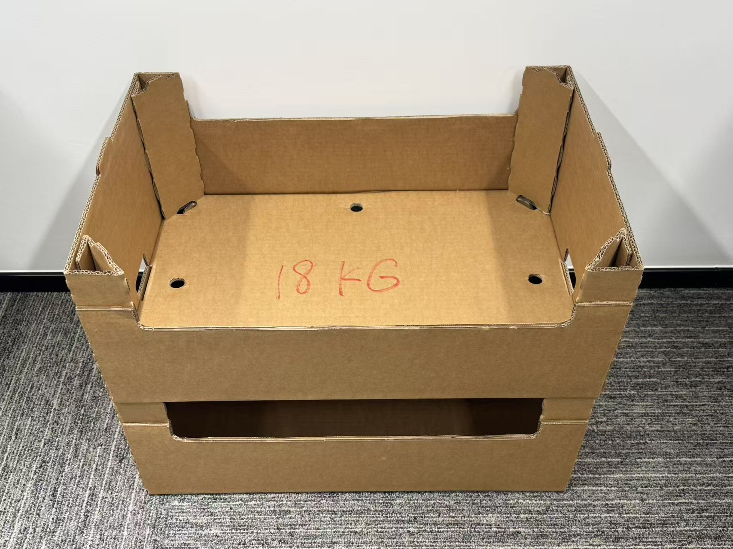
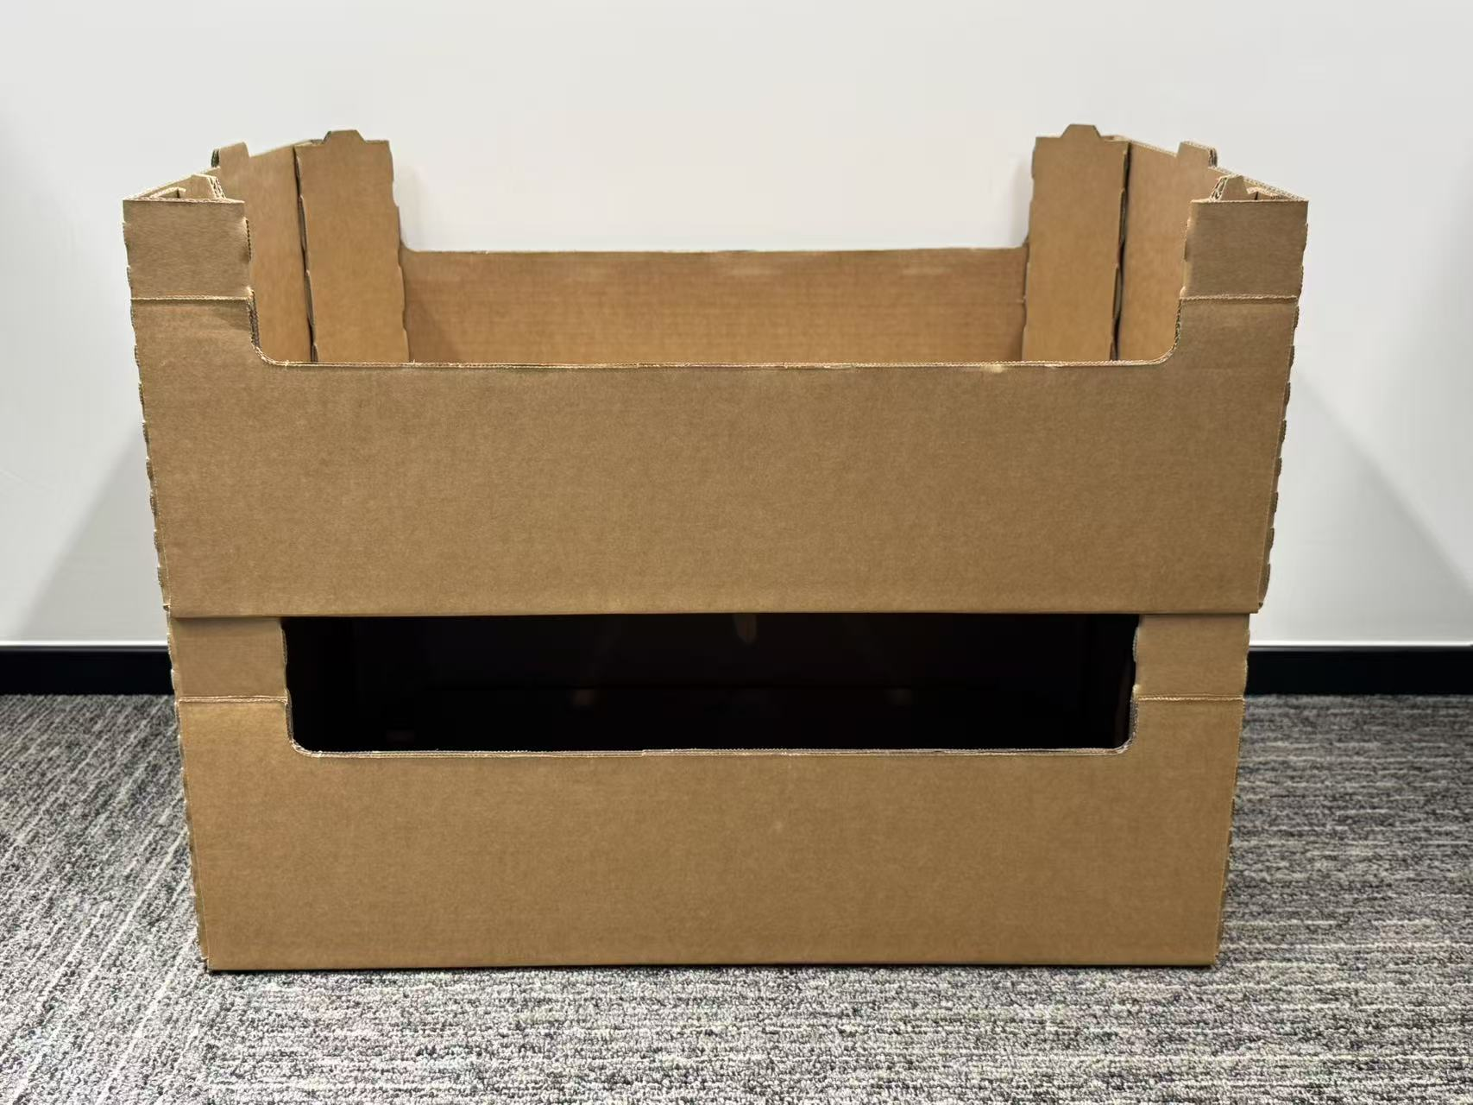
组 装 后 叠 放 实 物 展 示
Stacked Display

Slide 13
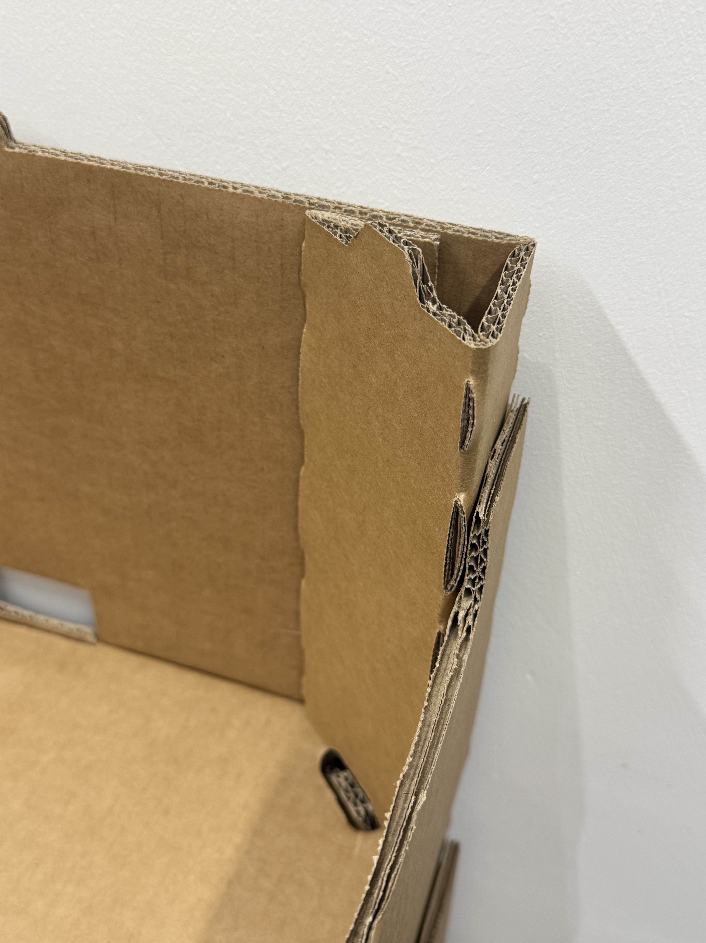
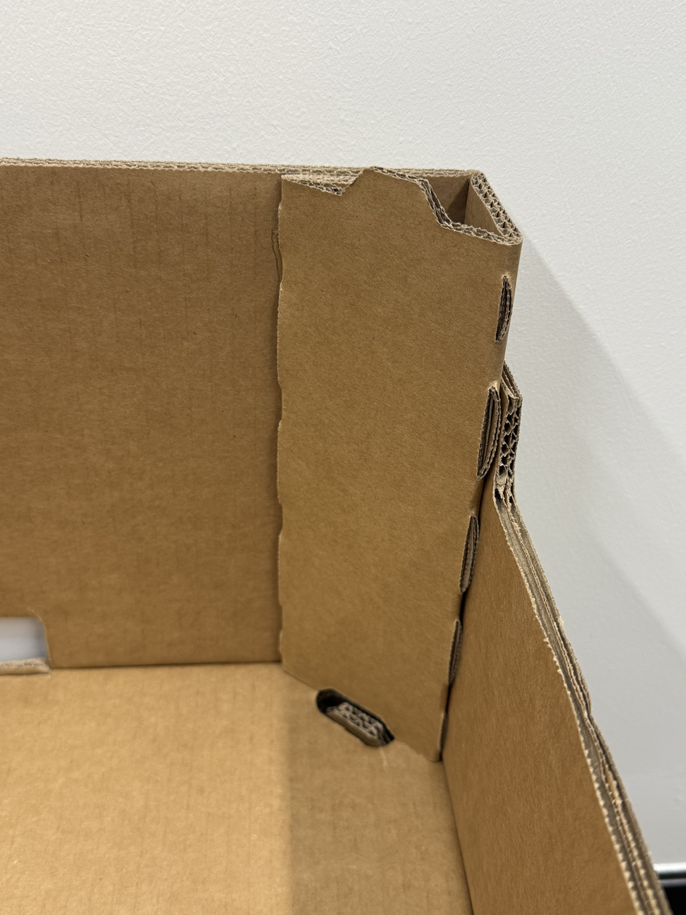
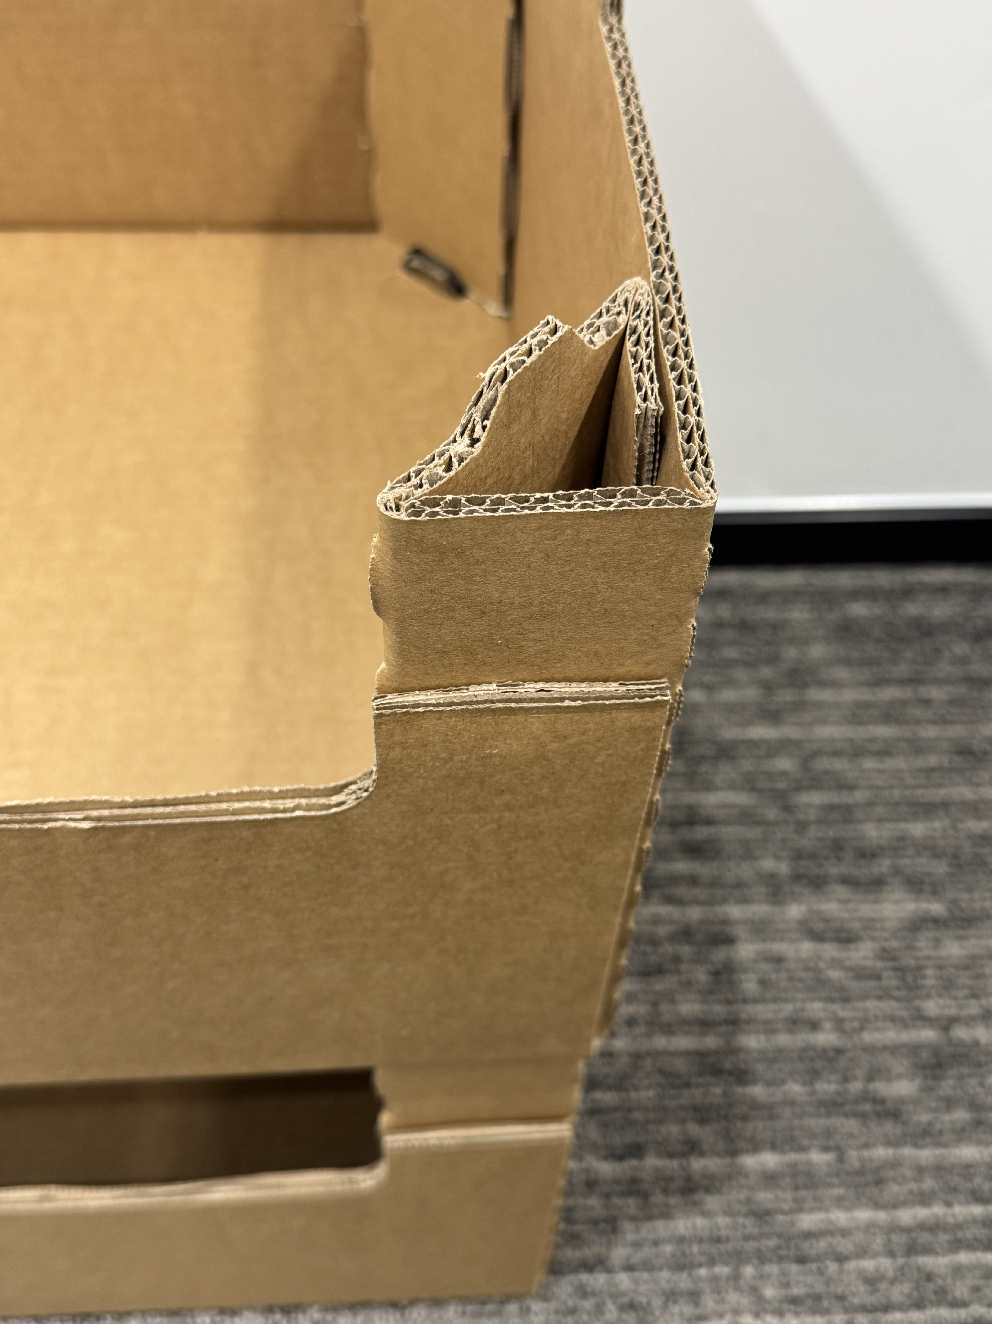
组 装 后 细 节 展 示
Detail Display

Slide 14
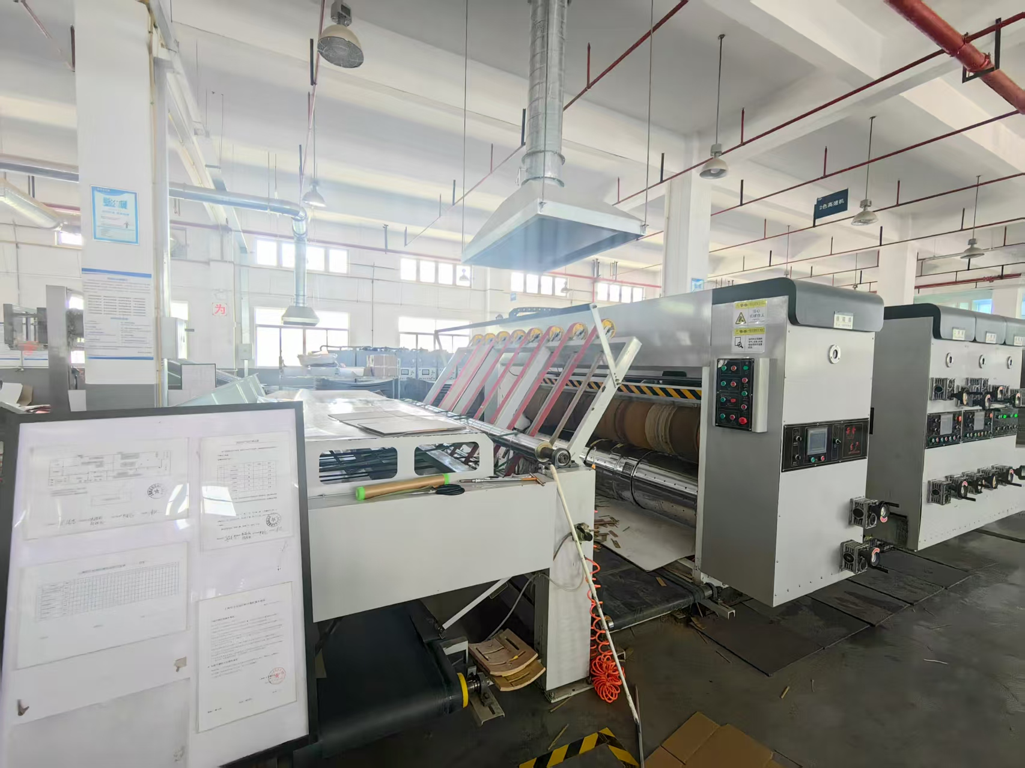
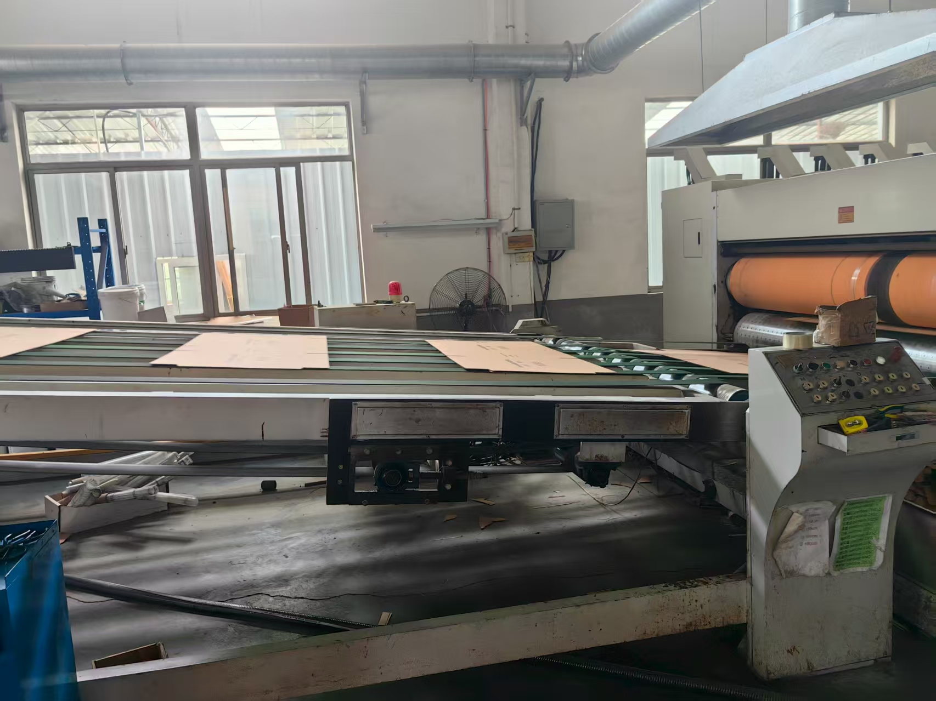

Slide 15
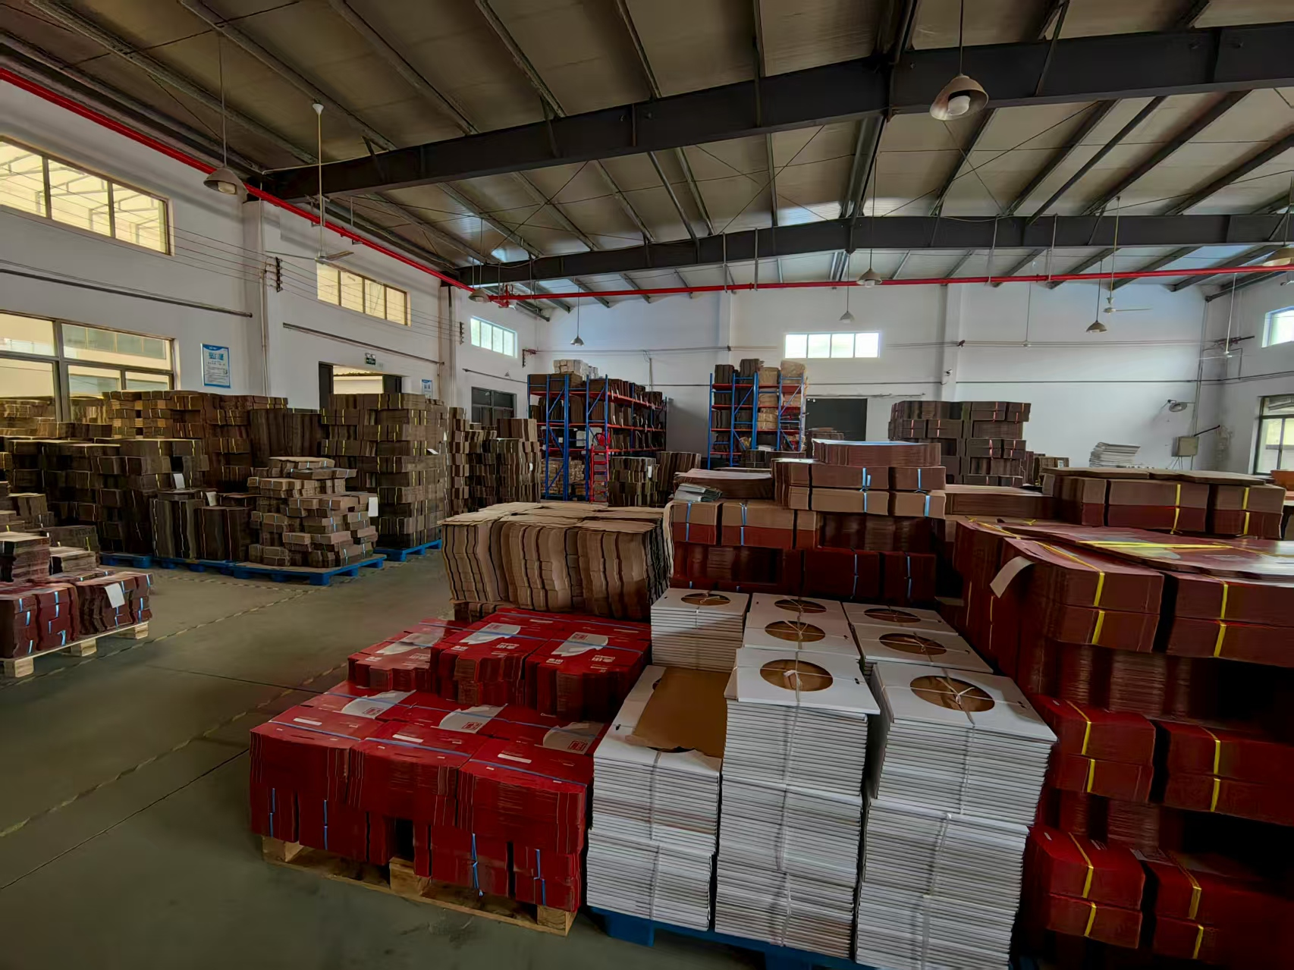
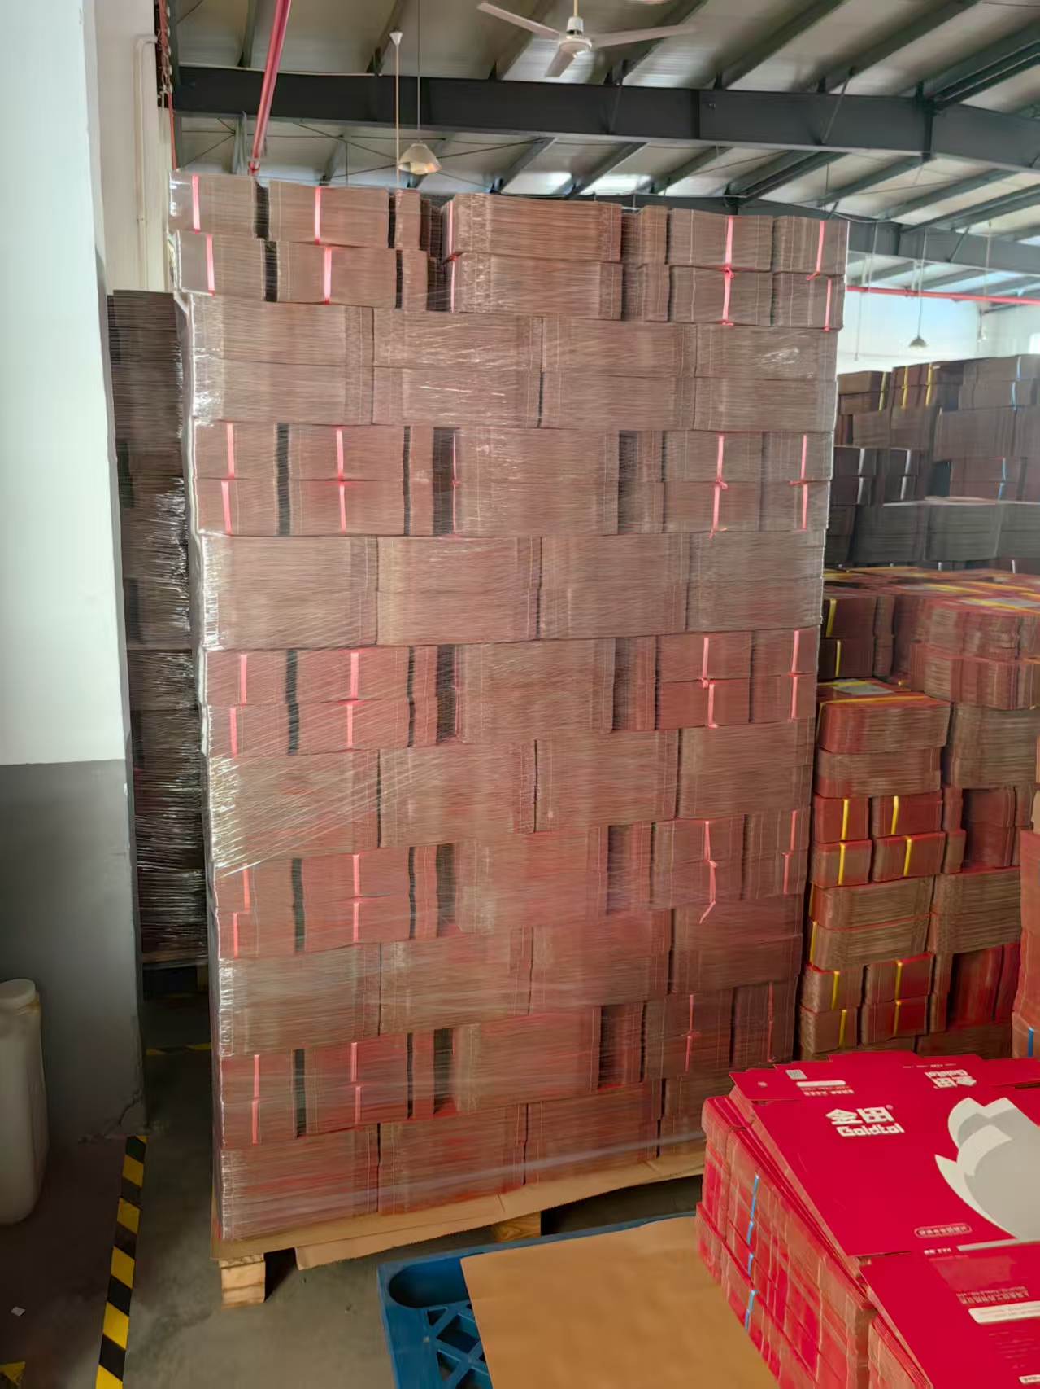

Slide 16
感谢观看
THANKS
公司名称：上海金弘通信息科技有限公司
Company Name：Shanghai Jinhongtong Information Technology Co., Ltd.
公司地址：上海市徐汇区瑞宁路899号上海阳光滨江中心2815室
Company Address ：Room 2815, Shanghai Sunshine Riverside Center, No. 899 Ruining Road, Xuhui District, Shanghai

